Slide 1



CSI Presentation
Study and addressing inter subject/session variabilities for CVEP based passive Brain Computer Interface
Student: Sébastien Velut
Supervisors et co-supervisor : Dehais Frédéric et Chevallier Sylvain, Corsi Marie-Constance
Jury : Clodic Aurélie, Vareilles Elise
Notes:
Je suis principalement à Paris

Slide 2
Summary
What is a BCI ?
Problem of variability in BCI
CVEP
What I did ?
Future direction
Formations / Conference

Slide 3


ANR Proteus
Measuring, understanding and tackling variabilities in Brain-Computer Interfacing

Slide 4
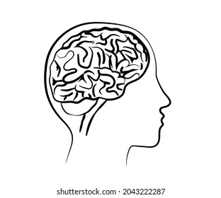
Introduction: Brain Computer Interface
Signal Processing
Preprocessing
Features extraction
Classification
Signal Acquisition
Application interface
Applications :
Spelling device
Wheelchairs
Video games
Mental state monitor

Slide 5
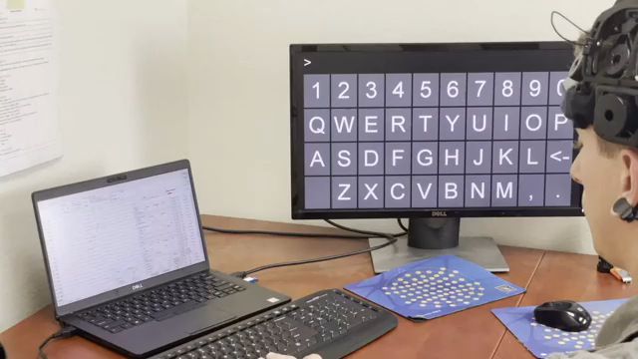
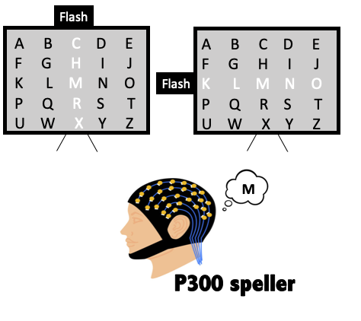
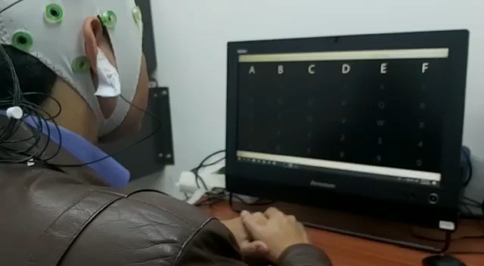
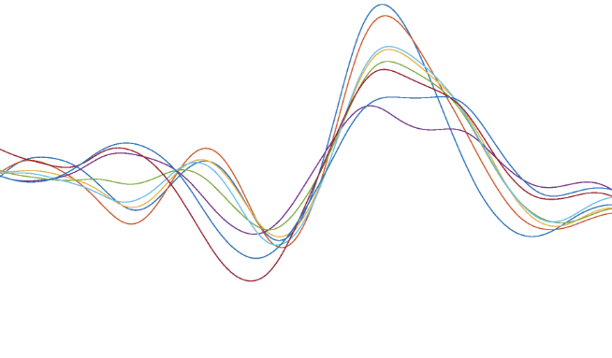
Introduction: SSVEP et P300
Steady State Visual Evoked Potential (SSVEP)

Slide 6
Introduction: Limitations
Long calibration time
Not reactive
SSVEP
P300
Highly reactive
Fixed decoding time / not self paced
Simple classification problem : Target VS Non Target
Synchronous / not self paced
Tiring and uncomfortable

Slide 7
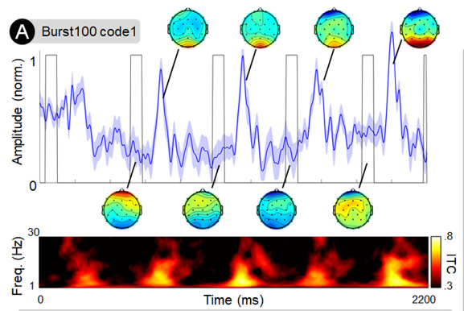
Introduction: Burst Code modulated Visual Evoked Potential
Few flashes per second (3 per second aperiodically)
Allows bitwise decoding
Strong response
Better SNR
[1] V. Martinez-Cagigal et al. Brain-computer interfaces based on code-modulated visual evoked potentials (c- VEP): a literature review. Journal of Neural Engineering, 2021. [2] K. Cabrera Castilloset al. Burst c-VEP based BCI: Opti- mizing stimulus design for enhanced classification with minimal calibration data and improved user experience. NeuroImage 2023.

Slide 8
Introduction: Variability inter subject/session
Anatomy:
Grey matter quantity
Leave one out of all (LOO)
Classifier adaptation
Features adaptation
Latent tranfer learning
Optimal transport
Human: way of life, education
Origines
Techniques de transfer learning
Physiologique : fatigue, concentration, stress, circadian rythm
Condition environnementale:
Luminosity, displacement of electrodes, noise
*[3]
*[4], [5], [6], [9]
Notes:
Il y a de la variabilité et on a peu de données pour essayer de contrer cela en plus que celles-ci sont bien bruité. Il faut donc passer par des techniques de transfer learning pour pouvoir avoir accès à l’information de plus de données.
Expliquer les différents points des transfer learning
Dataset sont pas beaucoup, souvent mal labelisé ou mal néttoyé. Voir même pas accessible.

Slide 9

MOABB : Mother Of All BCI Benchmark
Regroup an extansive list of freely available EEG datasets
Comprehensive benchmark of popular Brain-Computer Interface (BCI) algorithms
Several tools to help to analyse and evaluate classifiers
Datasets for Motor Imagery, P300, SSVEP, CVEP
[12] Sylvain Chevallier& al, "The largest EEG-based BCI reproducibility study for open science: the MOABB benchmark" HAL: hal-04537061, 2024
[14] Vinay Jayaram and Alexandre Barachant. "MOABB: trustworthy algorithm benchmarking for BCIs." Journal of neural engineering 15.6 (2018): 066011

Slide 10
Aim & Hypothesis
Study the variability between session and users in BCI
Reduce these variabilities
Application to BurstCVEP based BCI
Hypothesis 1:
The variability can come from different days and different environments
Hypothesis 2:
Riemannian manifold and deep learning algorithm can reduced the variabilities
Hypothesis 3:
The variabilities are reduced with BurstCVEP paradigm
Notes:
Avant de parler du programme fait, faire conclusion du contexte et dire que la thèse se situe entre la neuroscience et l’IA

Slide 11
What I did : Overview
13/11/2023
Aujourd’hui
Etat de l’art
State of the art
Mise dans MOABB d’un dataset CVEP
Add in MOABB a CVEP dataset
Data visualisation
First Conference paper
Helps with MOABB paper
Wavelet classifier
1 meeting every 2 weeks with Frederic, Sylvain and Marie-Constance
1 meeting every 3 months with the ANR
1 meeting every weeks with MOABB team

Slide 12
State of the art
91 articles in total
88 on EEG
40 on transfer learning
11 on variability
28 on riemannian manifold
36 on Deep Learning
20 on Other
88 on EEG
18 on CVEP
18 on MI
10 on SSVEP
16 on P300
26 on other paradigms

Slide 13

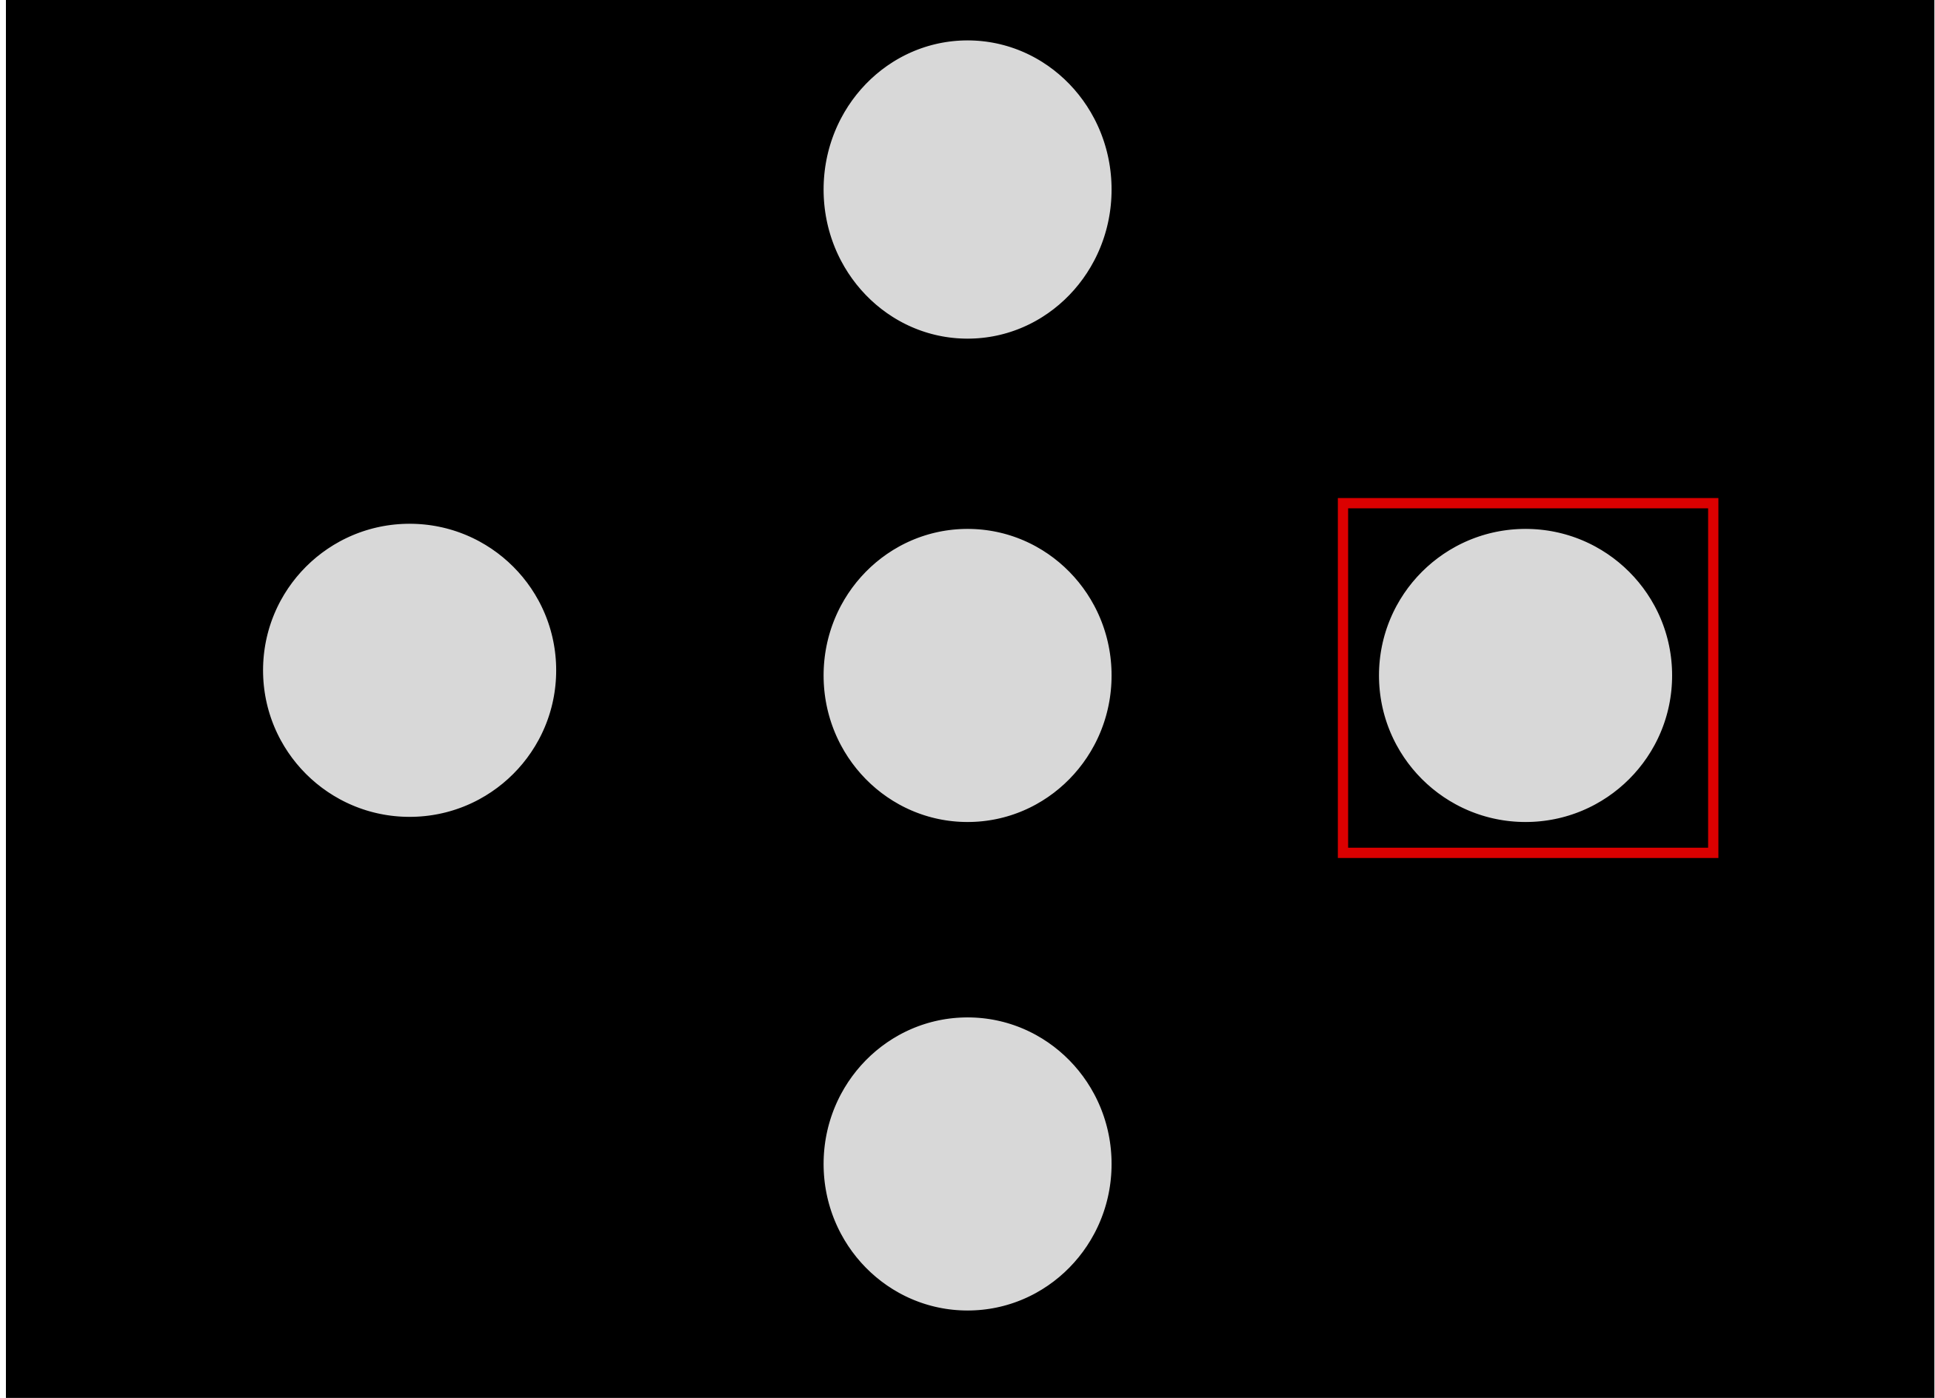
Implementation of Toulouse dataset in MOABB
Castillos Dataset
Burst-CVEP and CVEP based EEG
12 participants
1 session each
2 modes : CVEP et BurstCVEP
15 runs of 4 different 2,2s stimuli each
Why ?
Let the dataset easily accessible to everyone
Helps with FAIR principle
No burst-CVEP dataset and just one CVEP dataset
Facilitate the retrieving of data
Helps to perform statistical analysis with MOABB functions
1
2
4
3
[2] K. Cabrera Castillos, et al. Burst c-VEP based BCI: Opti- mizing stimulus design for enhanced classification with minimal calibration data and improved user experience. NeuroImage, page 11, 2023.
[12] S. Chevallier et al The largest eeg-based bci reproducibility study for open science: the moabb benchmark. arXiv preprint arXiv:2404.15319, 2024

Slide 14


Co-author on a MOABB paper
The largest EEG-based BCI reproducibility study for open science: the MOABB benchmark, Journal of neural engineering
Benchmark for MI, SSVEP and P300 paradigms and for Raw, Deep Learning and Riemannian algorithms
On several freely common available datasets
Helping to adapt figures, reviewing and calculating Information Transfer Rate
Calculate accuracy scores for common algorithms
Deliver a base in term of state of the art to compare in future studies
[12] S. Chevallier et al The largest eeg-based bci reproducibility study for open science: the moabb benchmark. arXiv preprint arXiv:2404.15319, 2024

Slide 15



First conference paper: Content
Deep Riemannian Neural Architectures for Domain Adaptation in Burst cVEP-based Brain Computer Interface, ESANN
Comparison between CNN and two types of SPDNet
Comparison between Domain Generalization, Domain Adaptation and Single Subject
Data are normalized, spatialy and temporaly filtered and spatialy recentered
Framewise decoding to reconstruct the code and perform template matching
Use of MOABB for stastitical analysis
Domain Generalization
Training/val data:
11 subjects
Testing data:
12th subject
Domain Adaptation
Training/val data:
11 subjects et a part of 12th subject
Testing data:
Rest of data from 12th subject
Single Subject
Training/val data:
A part of data from subject i
Testing data:
Rest of data from subject i
*[7], [8], [9], [10], [11]

Slide 16
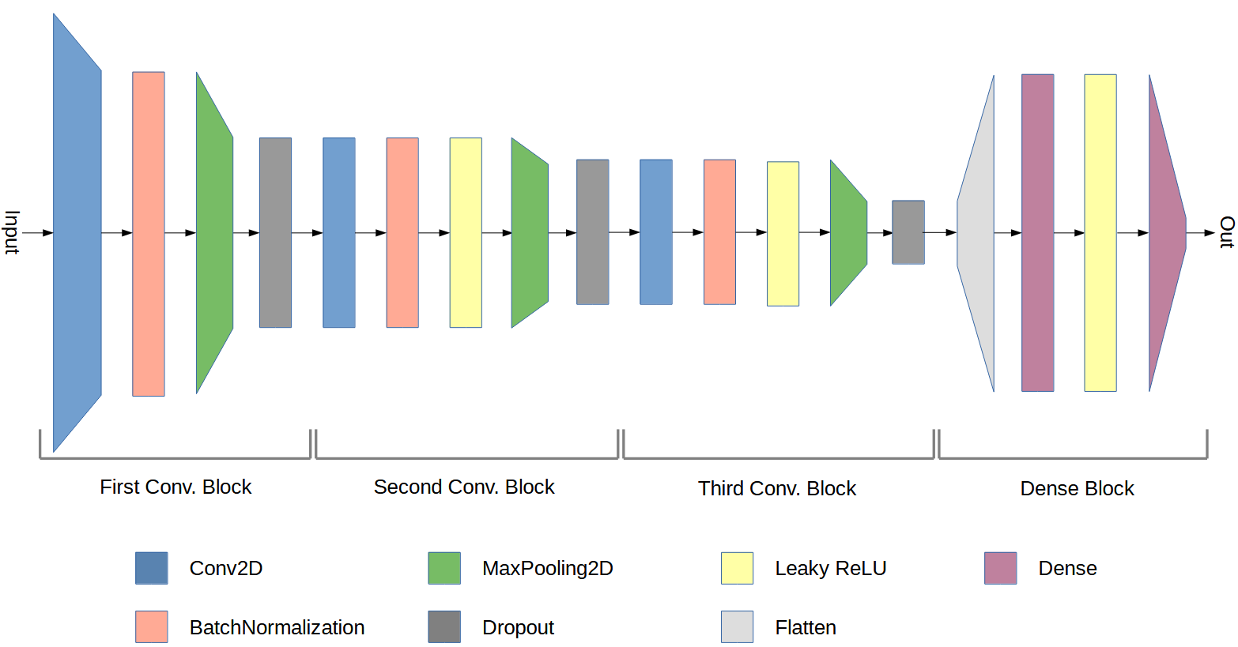
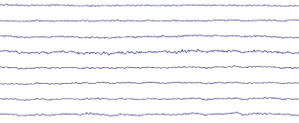

First conference paper: CNN
Deep Riemannian Neural Architectures for Domain Adaptation in Burst cVEP-based Brain Computer Interface, ESANN
Convolutional Neural Network (CNN)
[2] K. Cabrera Castilloset al. Burst c-VEP based BCI: Opti- mizing stimulus design for enhanced classification with minimal calibration data and improved user experience. NeuroImage 2023.

Slide 17
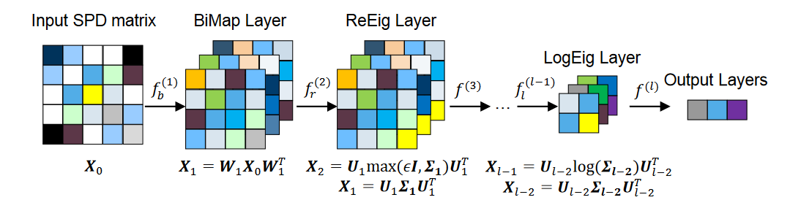
First conference paper: SPDNet
Deep Riemannian Neural Architectures for Domain Adaptation in Burst cVEP-based Brain Computer Interface, ESANN
Covariance
transformation
[10] Z. Huang and L. Van Gool. A riemannian network for SPD matrix learning. In AAAI, page 9, 2017
[11] R. Kobler et al. SPD domain-specific batch normalization to crack interpretable unsupervised domain adaptation in EEG. In NeurIPS, 2022.

Slide 18
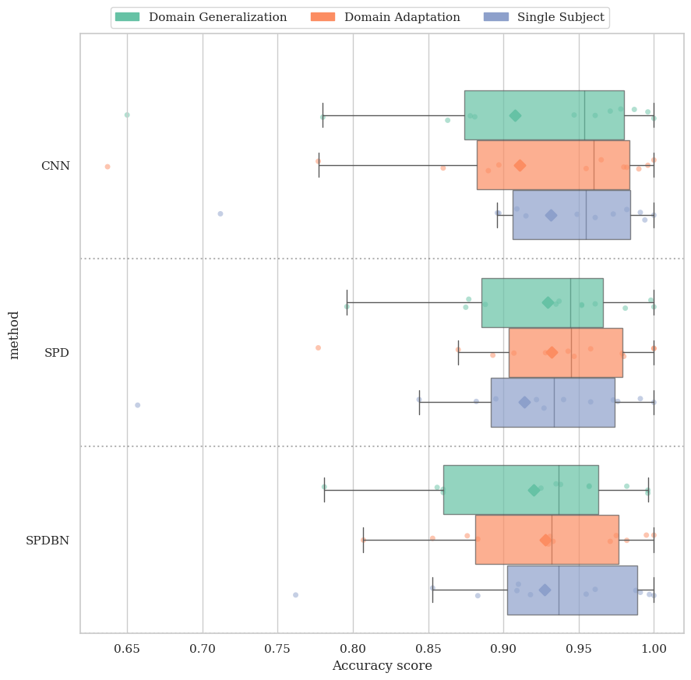
First conference paper: Results
Deep Riemannian Neural Architectures for Domain Adaptation in Burst cVEP-based Brain Computer Interface, ESANN
DA setting performs higher than DG setting
All three models show comparable performance without significant differences (except in SS setting)
~ 93% accuracy
Riemannian DeepLearning algorithms seems more consistent than CNN

Slide 19
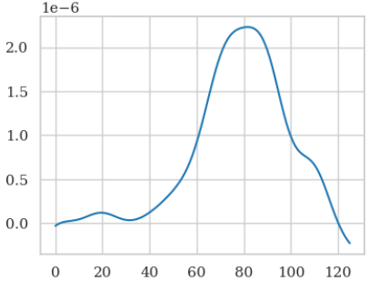
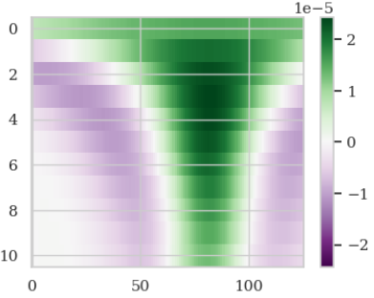
Wavelet Transform
Temporal (or spatial) information
Temporal (or spatial) & frequency information
Notes:
Dire que cela me permettra d’extraire des features

Slide 20
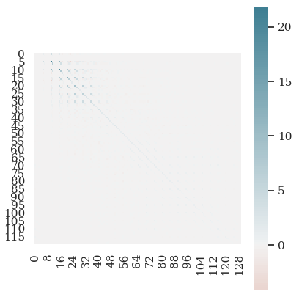
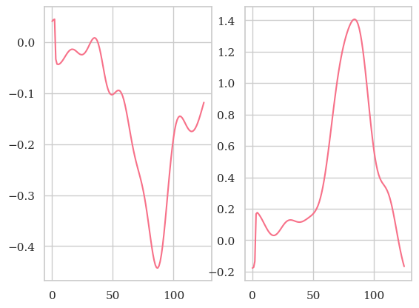
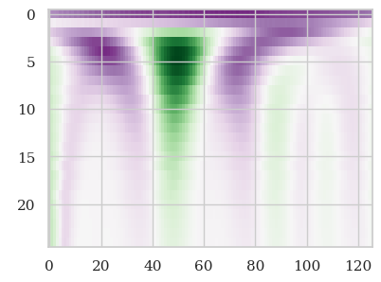
Testing Wavelet classifier
E x C x T
E x F x C x T
E x Q x T
(2,1)
X
Wavelet transformation
Covariance matrices + Shrinkage
SPDNet
y
[13] Paillard, Joseph et al. GREEN:a lightweight architecture using learnable wavelets and Riemannian geometry for biomarker exploration,2024
Notes:
Cela semblait une bonne idée car la transformée en wavelets (qui vient du processing de signal pour les images par exemple) permet d’avoir des informations temporelles ET fréquentielles

Slide 21
Future direction
Research with Jordy Thielen in Radboud University in march 2025 on simulation based inference
Conference, courses and formations
Analyze and use data from the ongoing experiment
Continue to improve and create classifiers to reduce variabilities

Slide 22

Formations
Science ethics and integrity
Open science
49h/100h
Grenoble neurotech school 2024
6 hours of lessons (Practical lessons) given at ISAE SUPAERO

Slide 23




Conference
NeuroErgonomics 2024
Co-author for a conference paper:
Passive CVEP based BCI to tag attention
ICML 2024
Attending/ Networking
Graz BCI 2024 (en septembre)
Co-presentor in a workshop on CVEP
ESANN 2024 (En octobre)
First author paper in oral:
Deep Riemannian Neural Architectures for Domain Adaptation in BcVEP-based BCI

Slide 24
Thank you for listening !

Slide 25
Références
[1] V. Martinez-Cagigal, J. Thielen, E. Santamaria-Vazquez, S. Perez-Velasco, P. Desain, and R. Hornero. Brain-computer interfaces based on code-modulated visual evoked potentials (c- VEP): a literature review. Journal of Neural Engineering, page 22, 2021. [2] K. Cabrera Castillos, S. Ladouce, L. Darmet, and F. Dehais. Burst c-VEP based BCI: Opti- mizing stimulus design for enhanced classification with minimal calibration data and improved user experience. NeuroImage, page 11, 2023. [3] S. Saha and M. Baumert. Intra- and inter-subject variability in EEG-based sensorimotor brain computer interface: A review. Frontiers in Human Neuroscience, page 8, 2020. [4] S. Khazem, S. Chevallier, Q. Barth ́elemy, K. Haroun, and C. Noˆus. Minimizing subject- dependent calibration for bci with riemannian transfer learning. In IEEE/EMBS Conference on Neural Engineering (NER), pages 523–526, 2021. [5] F. Fahimi, Z. Zhang, W. Boon Goh, T. Lee, K. Keng Ang, and C. Guan. Inter-subject transfer learning with end-to-end deep convolutional neural network for EEG-based BCI. Journal of Neural Engineering, page 13, 2018. [6] B. Aristimunha, R. Y. de Camargo, W. H. Lopez Pinaya, S. Chevallier, A. Gramfort, and C. Rommel. Evaluating the structure of cognitive task with transfer learning. In NeurIPS workshop AI4Science, page 19, 2023. [7] A. Barachant, S. Bonnet, M. Congedo, and C. Jutten. Classification of covariance matrices using a Riemannian-based kernel for BCI applications. Neurocomputing, 112:172–178, 2013. [8] F. Yger, M. Berar, and F. Lotte. Riemannian approaches in brain-computer interfaces: A review. IEEE TNSRE, 25(10):1753–1762, 2017. [9] P. Zanini, M. Congedo, C. Jutten, S. Said, and Y. Berthoumieu. Transfer learning: a riemannian geometry framework with applications to brain-computer interfaces. IEEE TBME, page 12, 2018. [10] Z. Huang and L. Van Gool. A riemannian network for SPD matrix learning. In AAAI, page 9, 2017. [11] R. Kobler, J. Hirayama, Q. Zhao, and M. Kawanabe. SPD domain-specific batch normalization to crack interpretable unsupervised domain adaptation in EEG. In NeurIPS, 2022. [12] S. Chevallier, I. Carrara, B. Aristimunha, P. Guetschel, S. Sedlar, B. Lopes, S. Velut, S. Khazem, and T. Moreau. The largest eeg-based bci reproducibility study for open science : the moabb benchmark. arXiv preprint arXiv:2404.15319, 2024.
[11] R. Kobler, J. Hirayama, Q. Zhao, and M. Kawanabe. SPD domain-specific batch normalization to crack interpretable unsupervised domain adaptation in EEG. In NeurIPS, 2022. [12] S. Chevallier, I. Carrara, B. Aristimunha, P. Guetschel, S. Sedlar, B. Lopes, S. Velut, S. Khazem, and T. Moreau. The largest eeg-based bci reproducibility study for open science: the moabb benchmark. arXiv preprint arXiv:2404.15319, 2024
[13] Paillard, Joseph & Hipp, Joerg & Engemann, Denis. (2024). GREEN: a lightweight architecture using learnable wavelets and Riemannian geometry for biomarker exploration,2024 .
[14] Vinay Jayaram and Alexandre Barachant. "MOABB: trustworthy algorithm benchmarking for BCIs." Journal of neural engineering 15.6 (2018): 066011

Slide 26
Repartition between ISAE and LISN
LISN (in Saclay)
Most of the time (due to familial reason)
Work on AI (Deep learning, Transfer Learning)
Work on Mathematics (Riemannian Manifold)
Work on MOABB
Online formations
Courses
ISAE SUPAERO (in Toulouse)
1/2 week every two months
Work on Neuroscience
Discussion about paradigms (BurstCVEP)
Performing experiments
In-person formations
Courses

